Slide 1
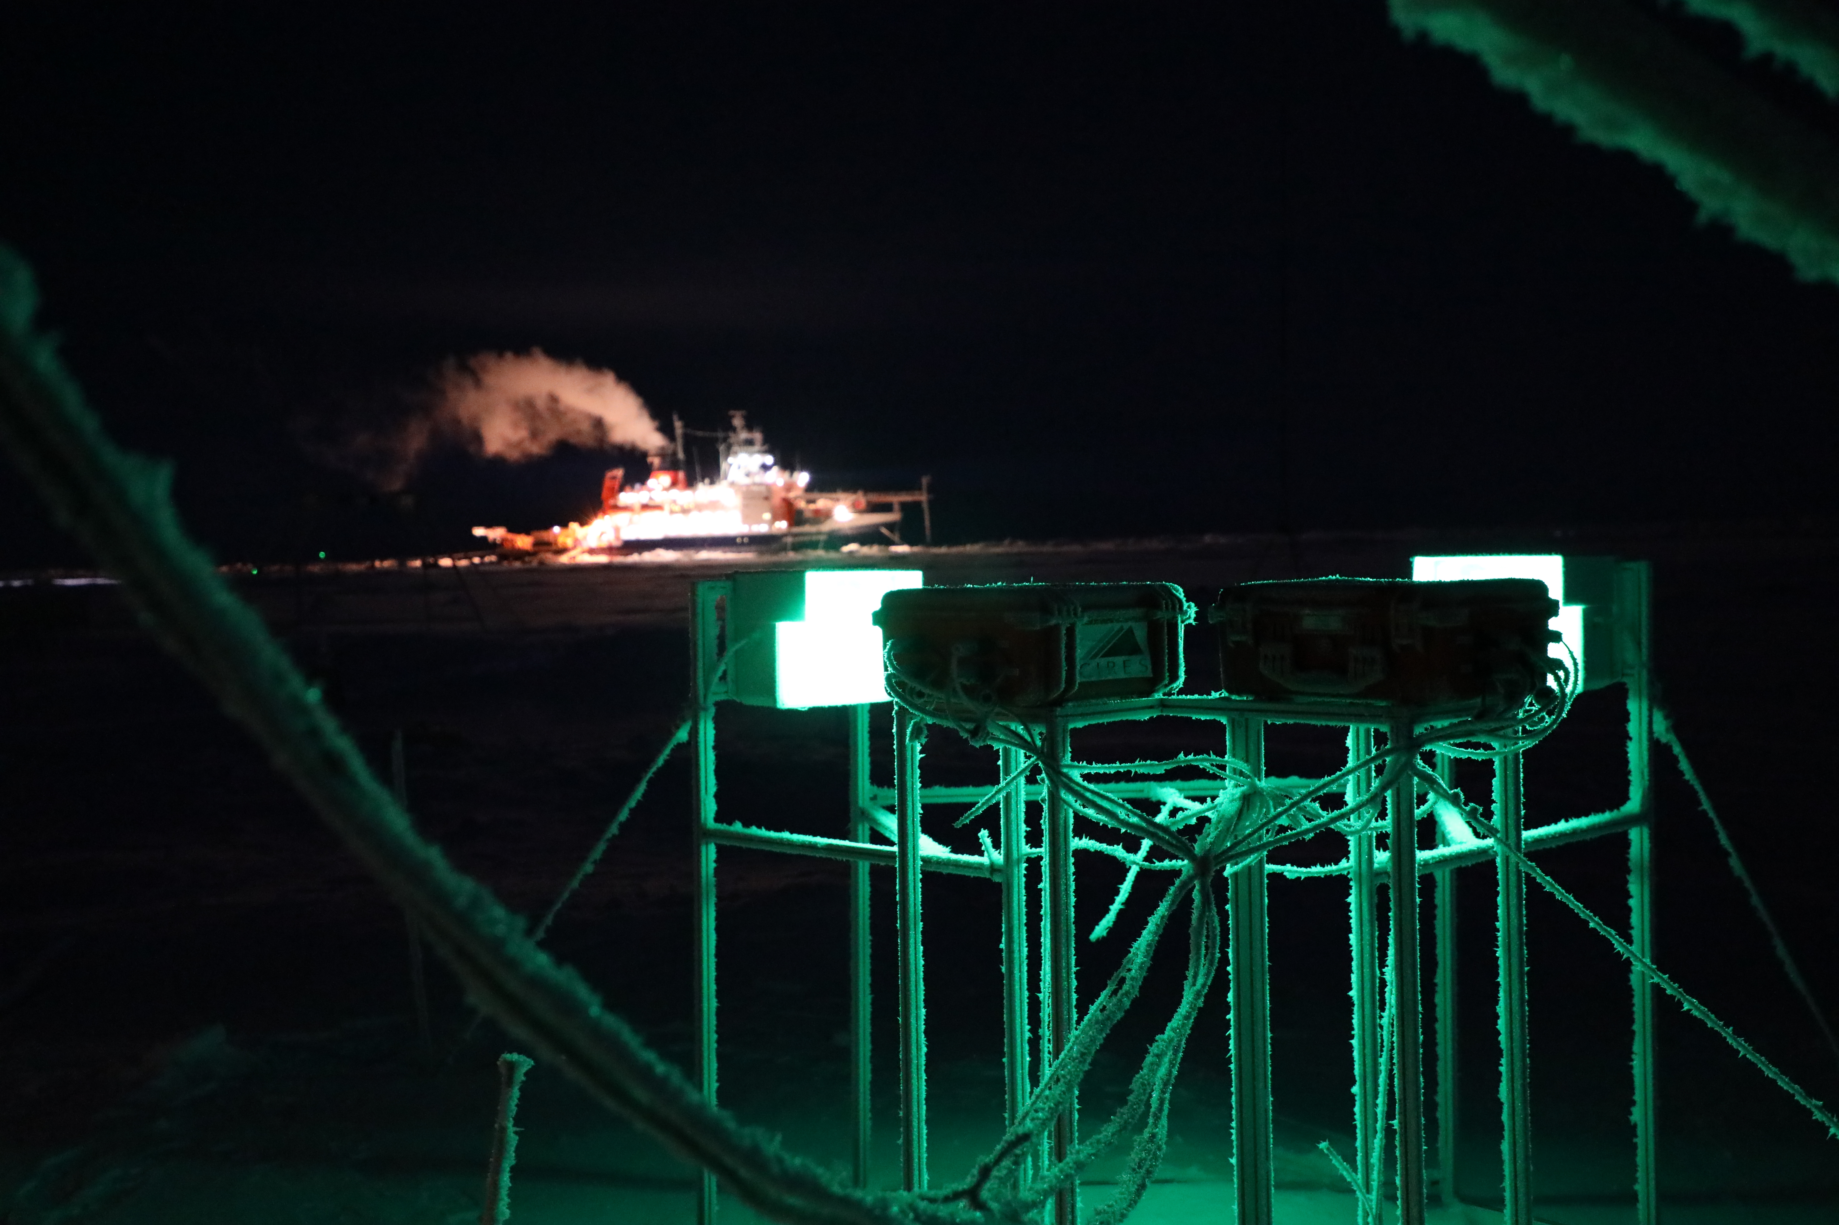

Slide 2
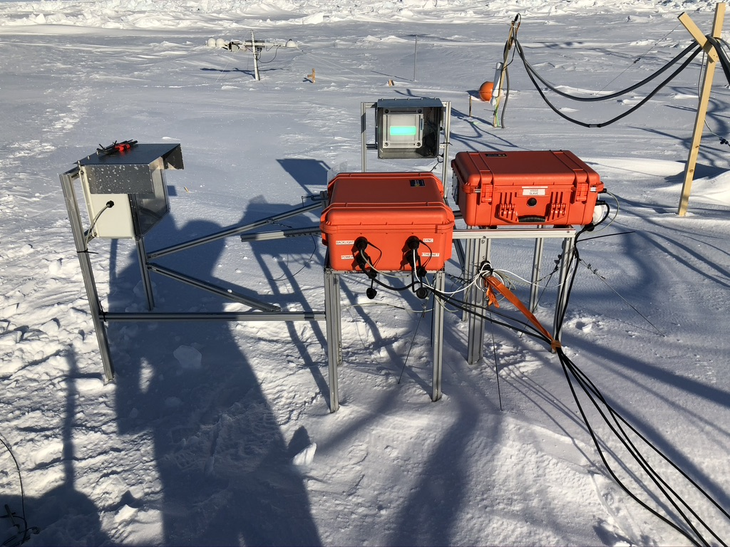

Slide 3
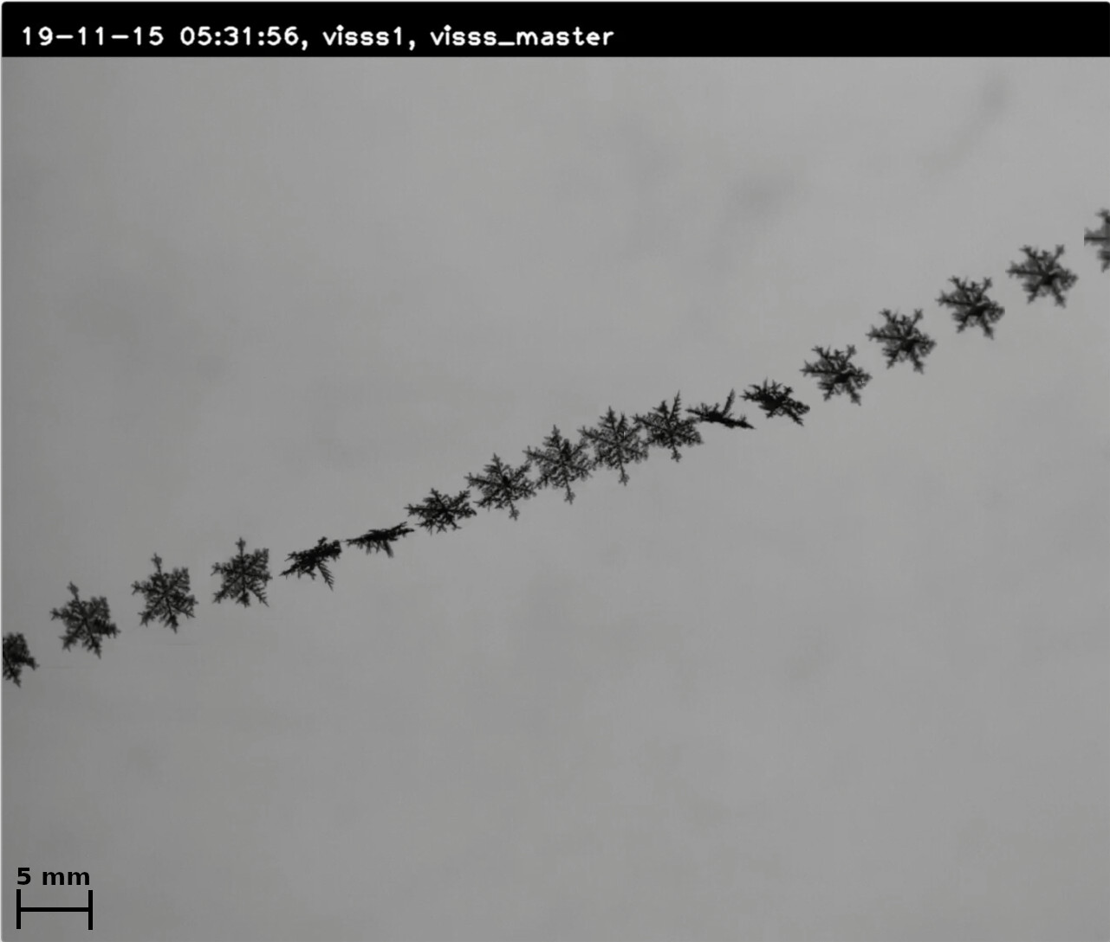

Slide 4
Specs
Resolution ~60 um
Measurement volume 6x8x8 cm
Movie continuously recorded
Wind sensitive…

Slide 5
Optical retrieval
PSD
Tracking
Degree of riming (&LWP)
Shape classification
climatology
Compare with 2dvd
Radar sensitivity study
Spectra features
Higher moments
Snowfall rate retrieval
Combining radar and VISSS
snowfall best estimate
Mass size relation closure
Qualitative analysis
blowing snow vs precip
Evaluate snowpack modelling
Impact of shape
Impact of size
(climate?) model evaluation/enhancement

